Slide 1

Fantasy
Group 6
Ben Le, Jiayin Ma, Mengyu Jia, Shanxing Gao, Neha Gupta

Slide 2
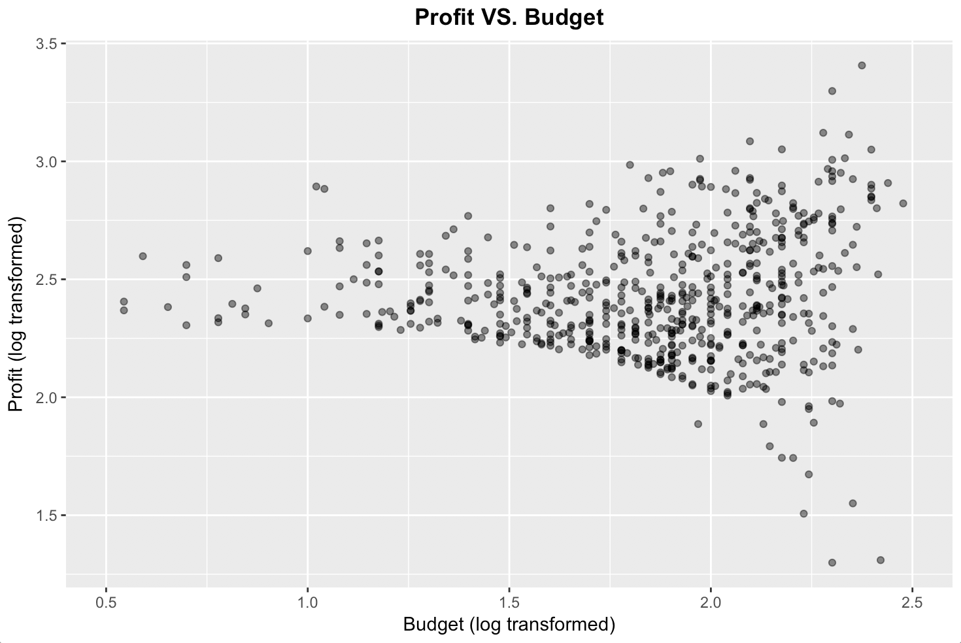
Two Different Winning Strategies
Profit
Risk-taking
Risk Preference
ROI
Risk-averse

Slide 3
Strategy 1: Maximum Profit
Director
Studio
Max Profit
Genre
Run-time
Launch Date

Slide 4
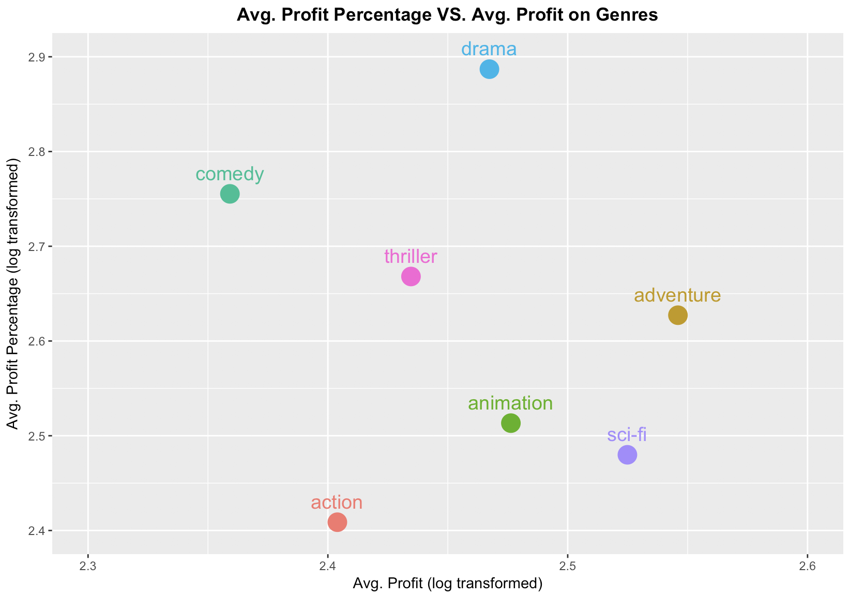
Max Profit → Best Genre = Adventure
Strategy 1: Max Profit
Max Profit Genre

Slide 5
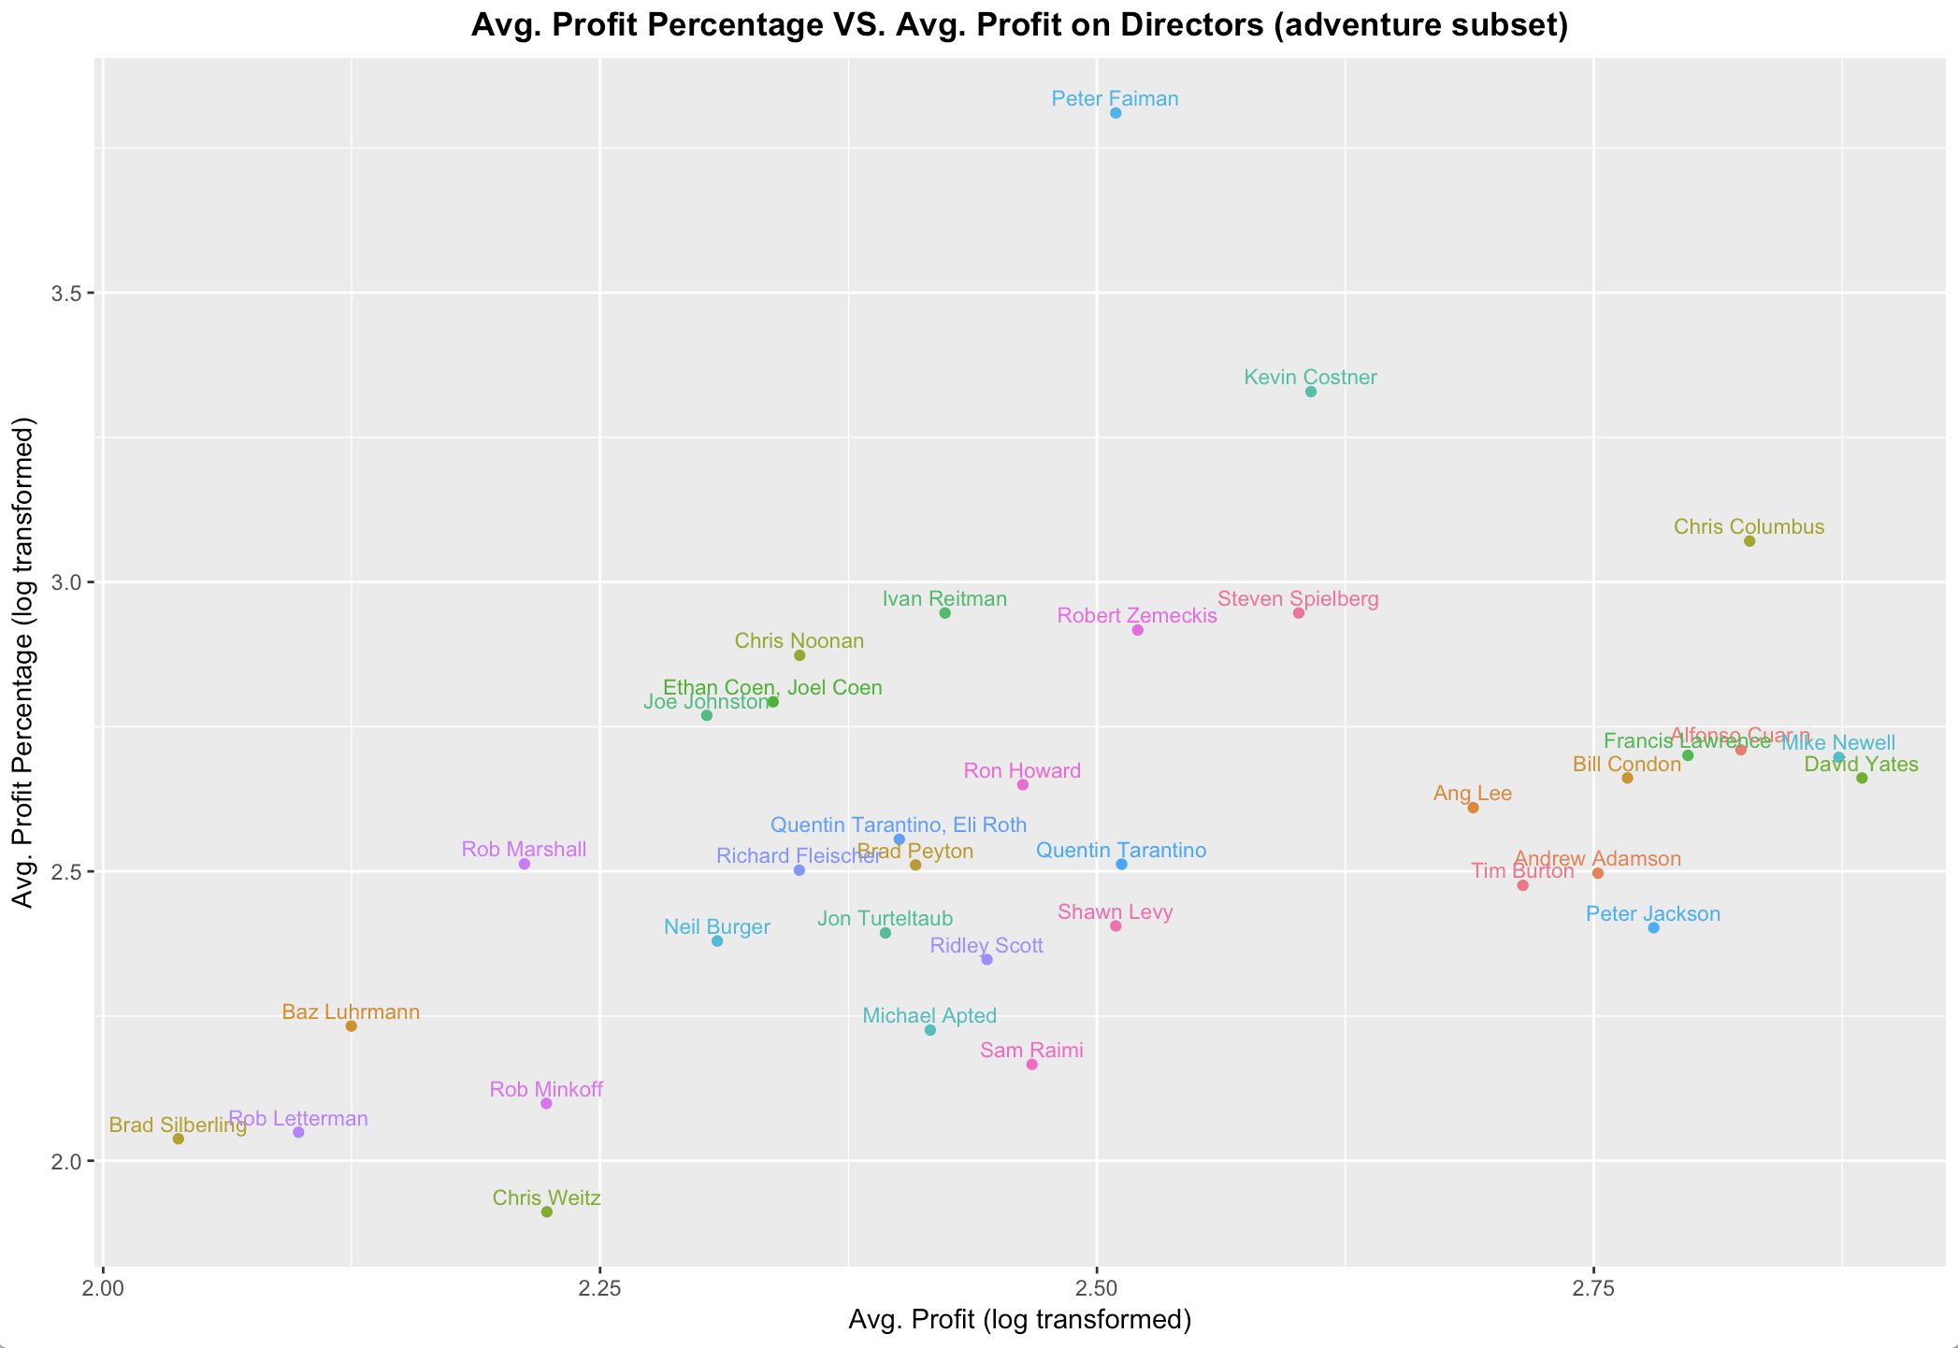
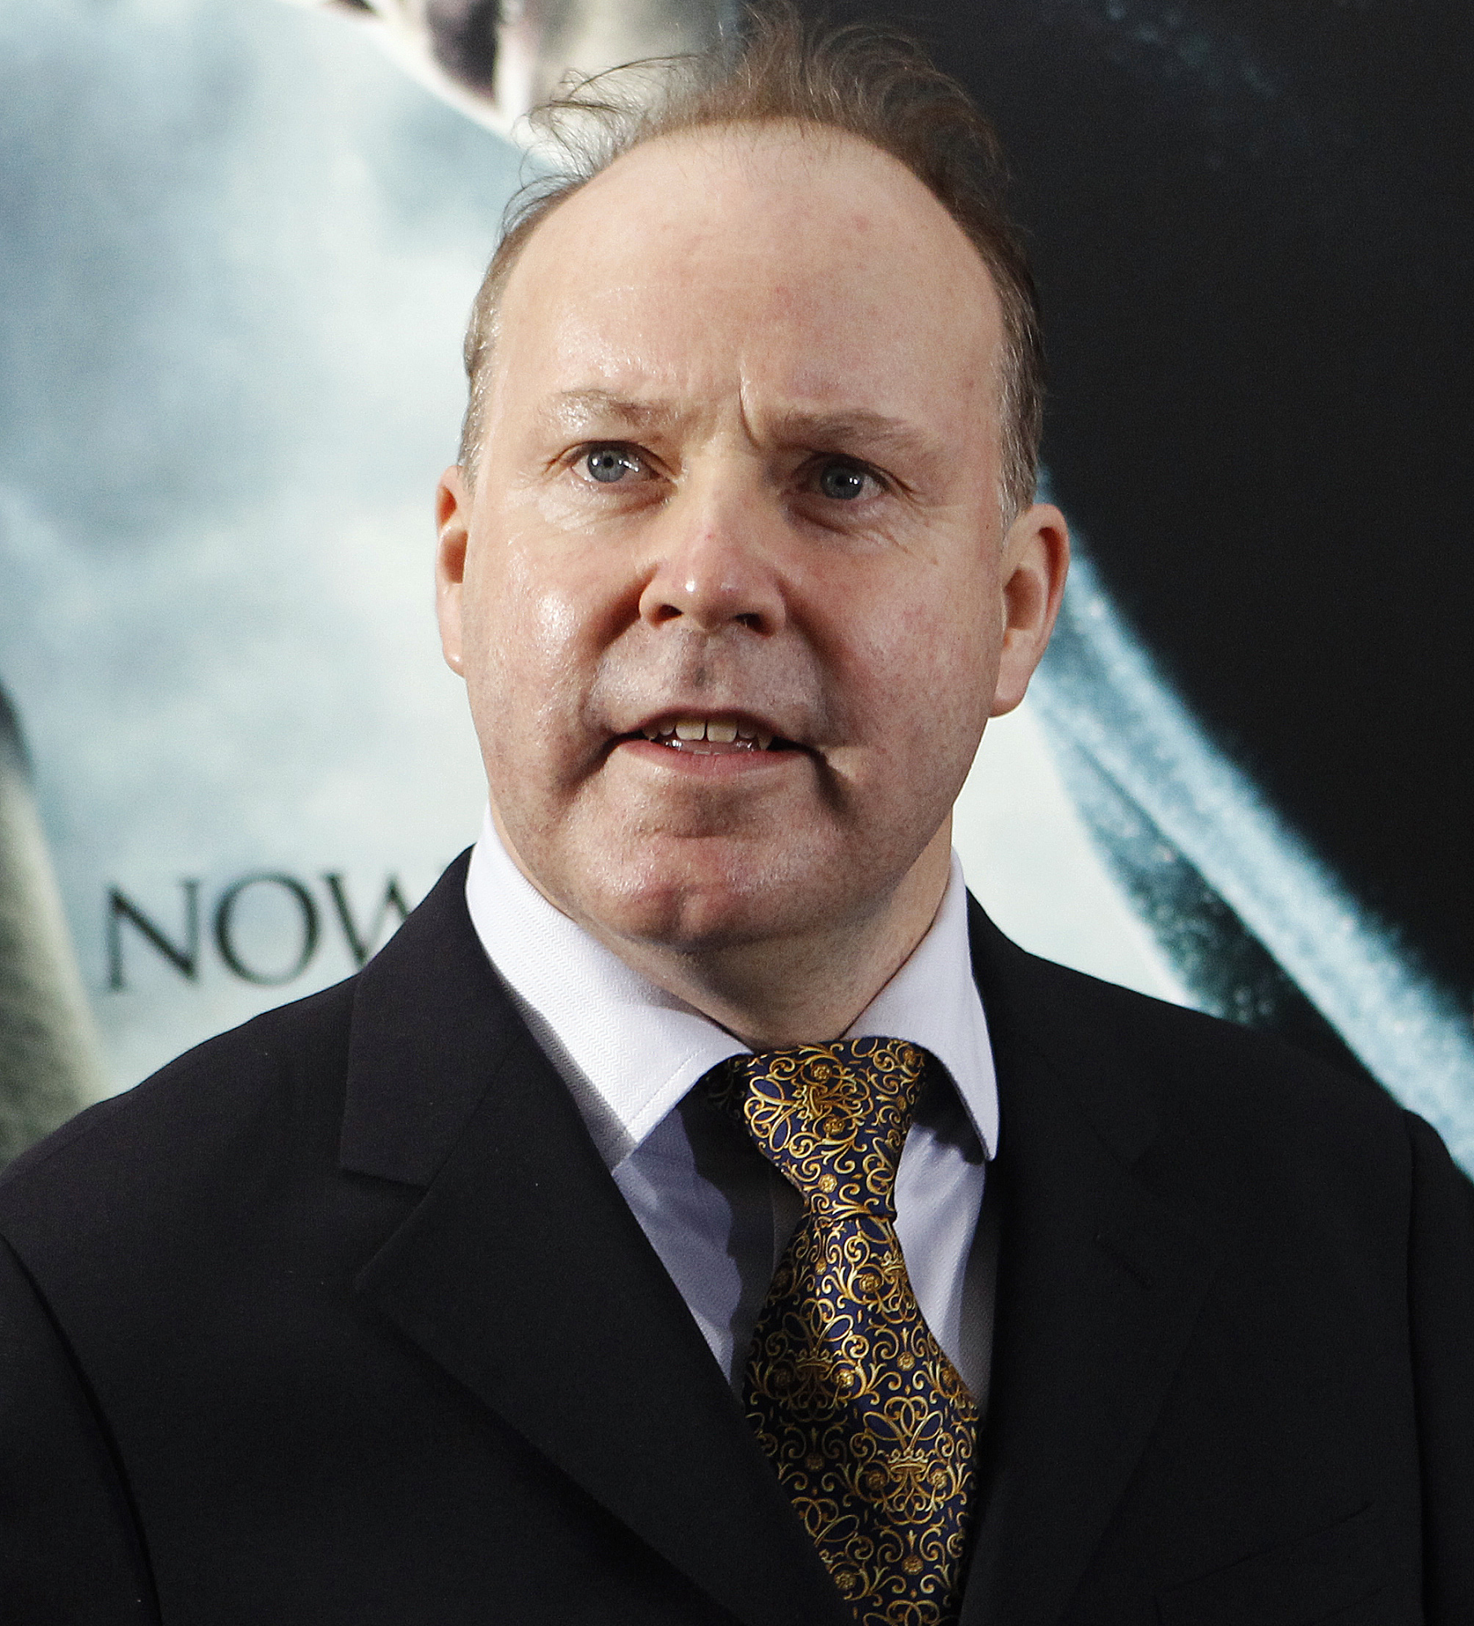
Adventure → Best Director = David Yates
Strategy 1: Max Profit
Max Profit Director
David Yates

Slide 6
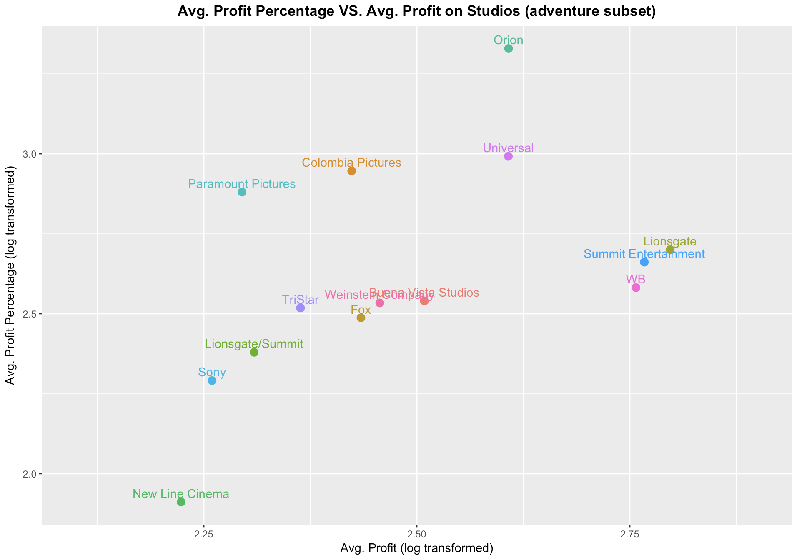
Adventure → Best Studio = Lionsgate
Strategy 1: Max Profit
Max Profit Studio

Slide 7
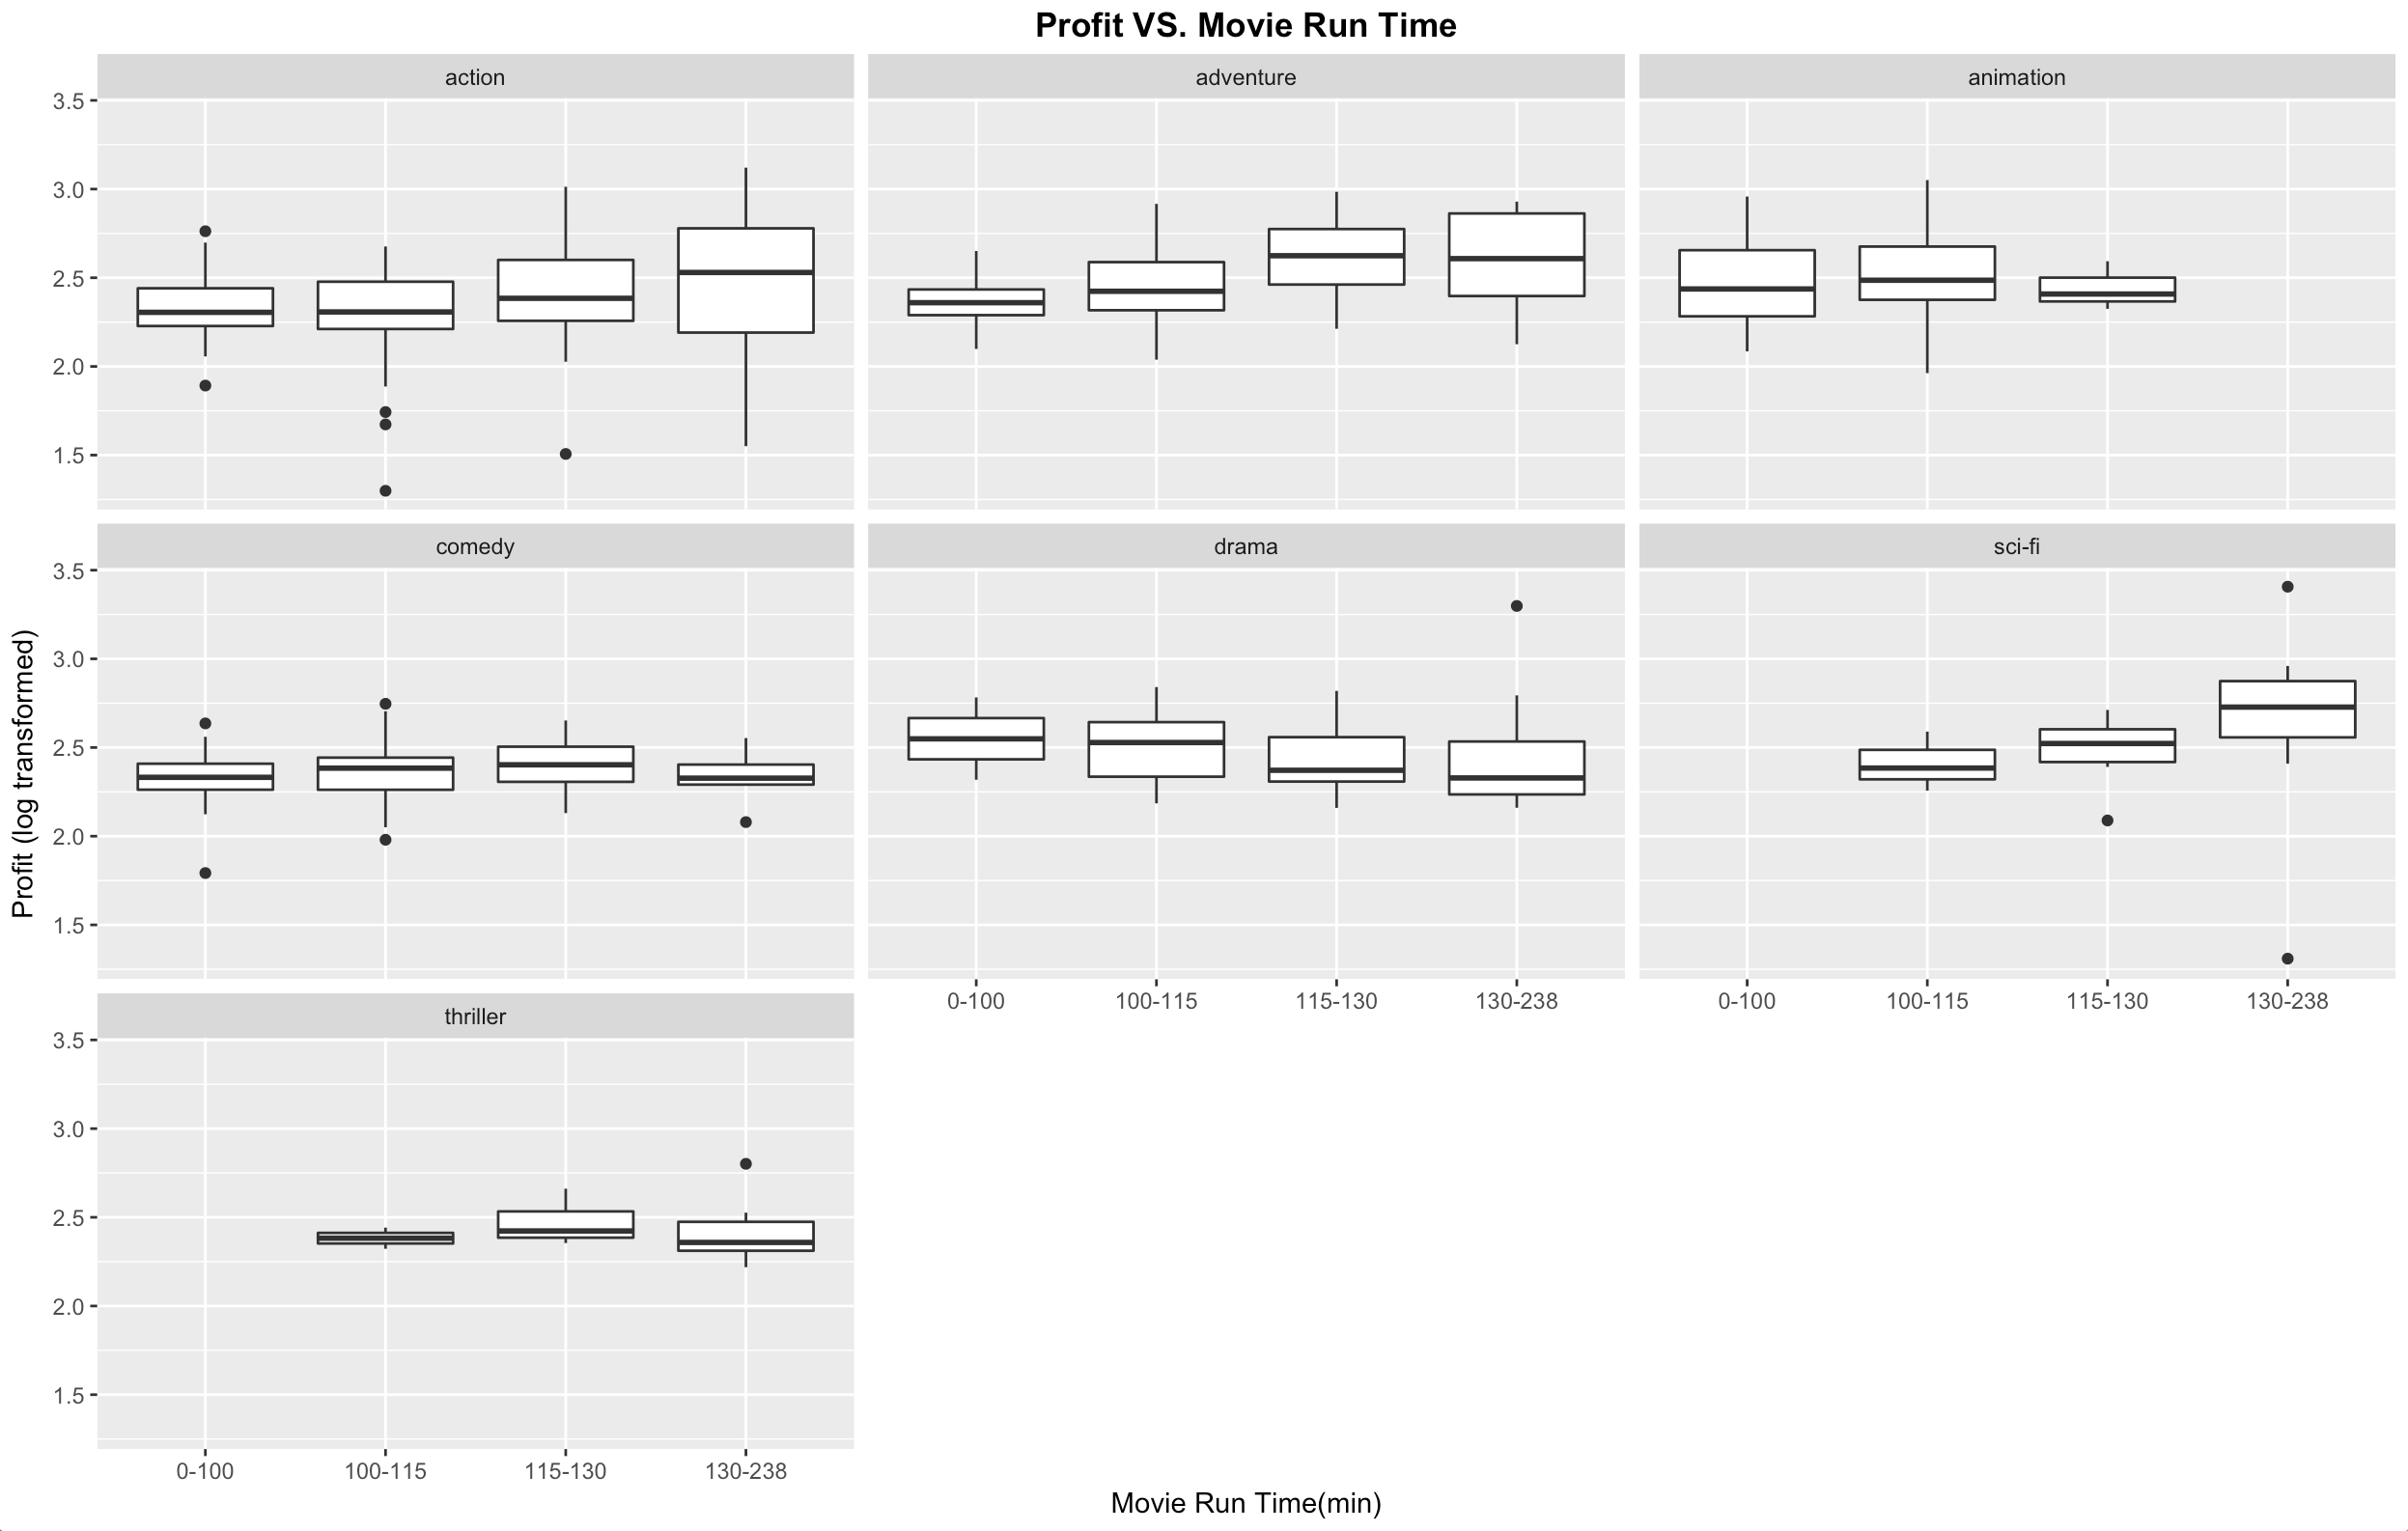
Adventure → Best Run-time = 115-130 mins
Strategy 1: Max Profit

Slide 8
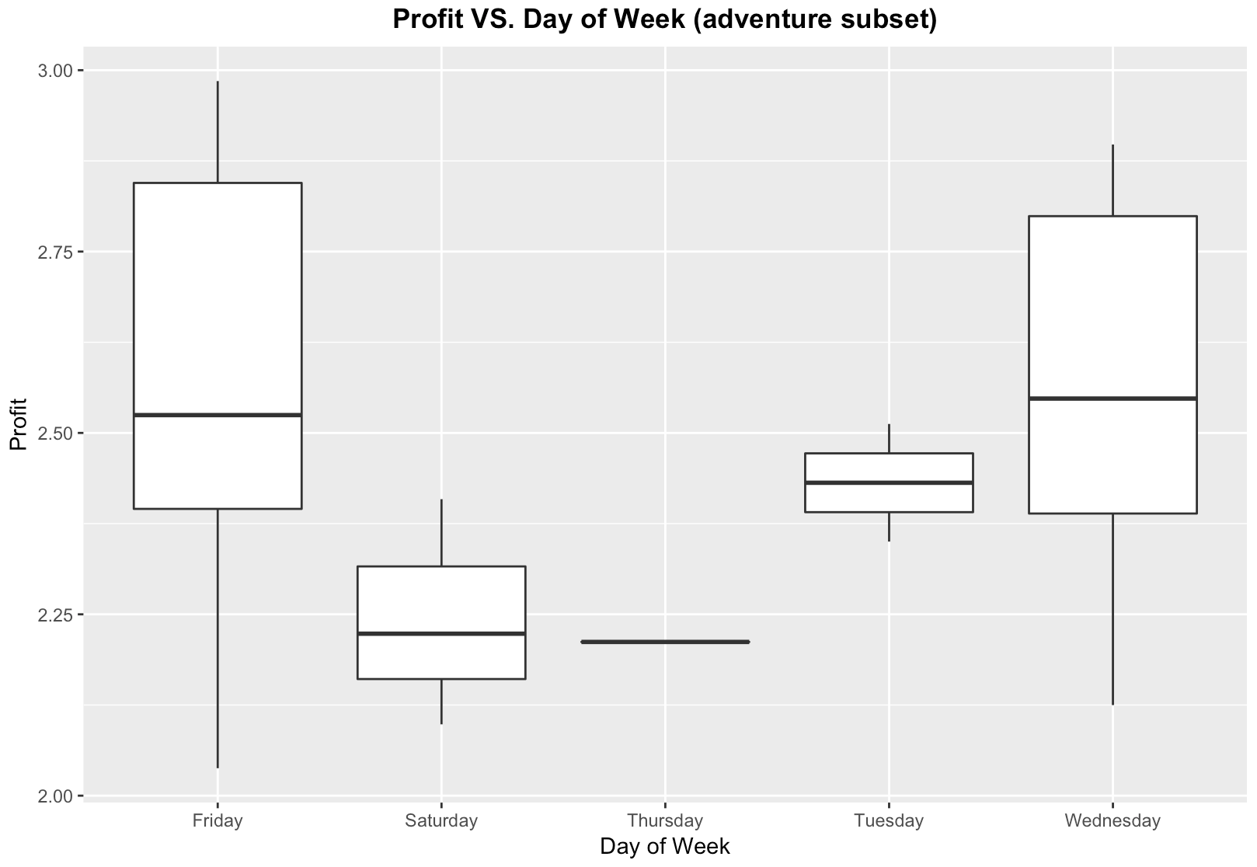
Adventure → Best Launch Date = Friday
Strategy 1: Max Profit

Slide 9
Strategy 2: Maximum ROI
Director
Studio
Max ROI
Genre
Run-time
Launch Date

Slide 10
Max ROI → Best Genre = Drama
Strategy 2: Max ROI
Max Profit ROI

Slide 11
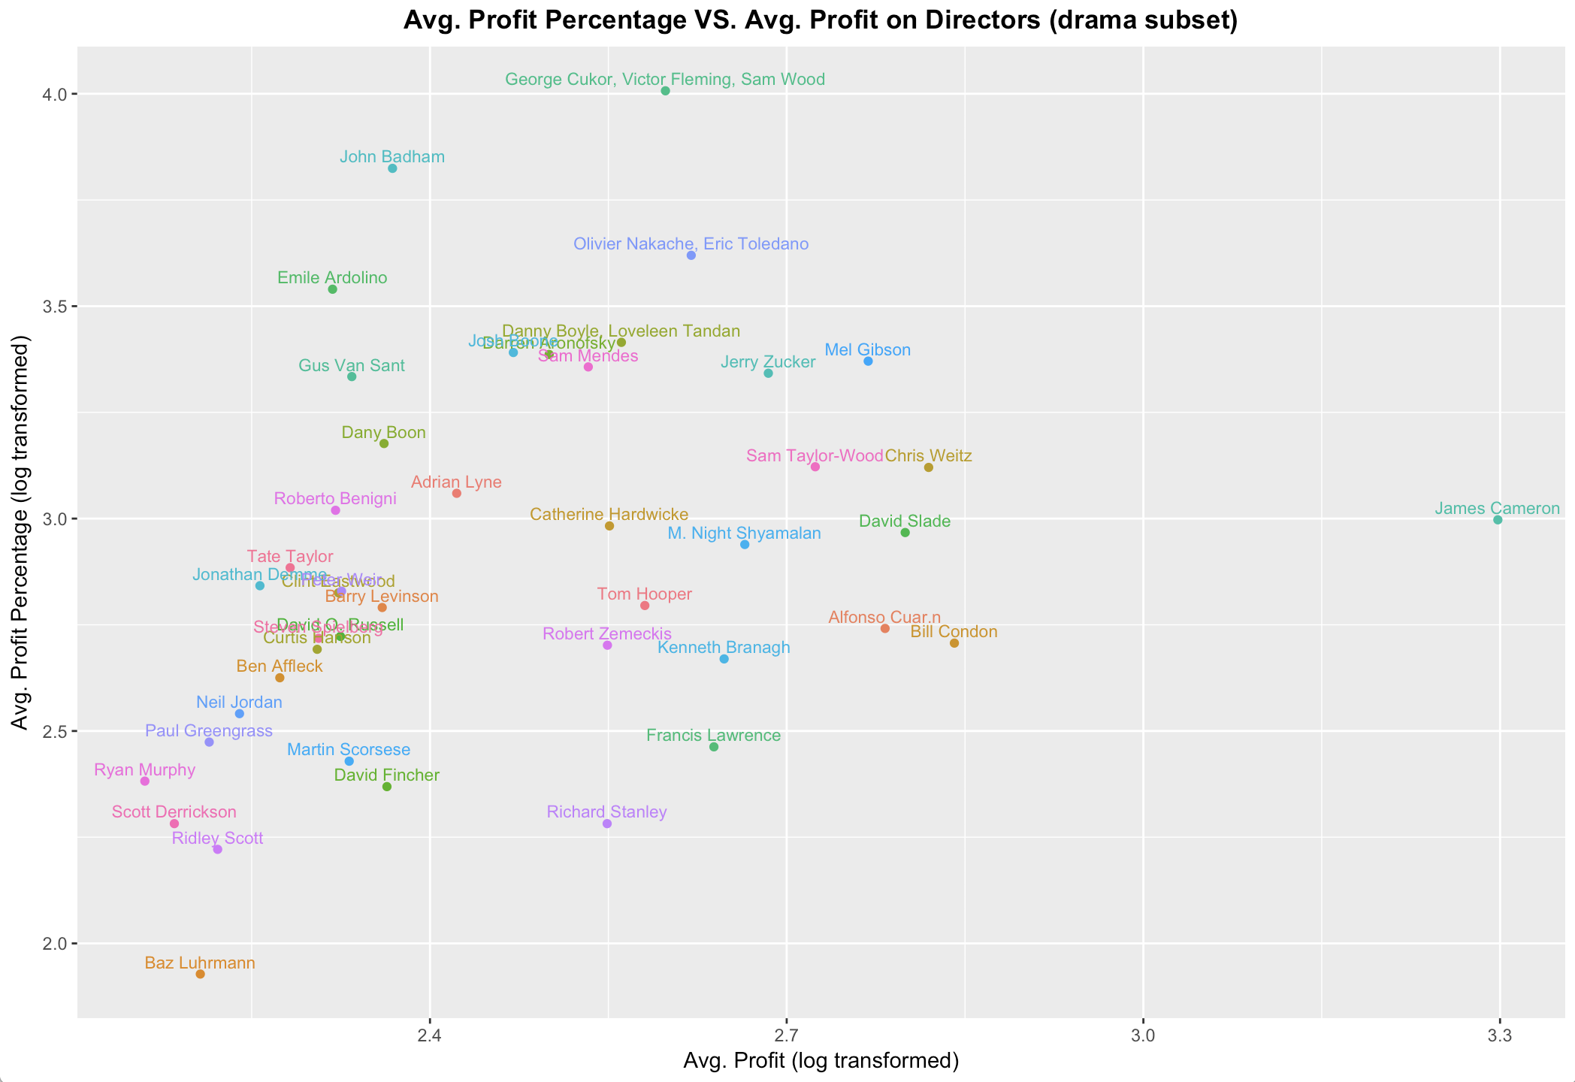
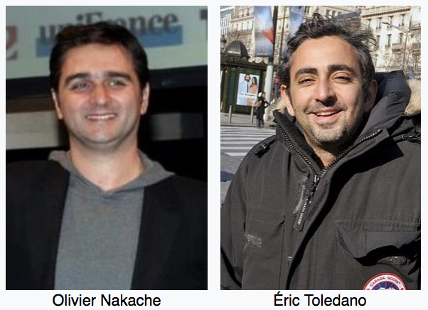
Drama → Best Director = Olivier Nakache &
Eric Toledano
Strategy 2: Max ROI
Max ROI Director

Slide 12
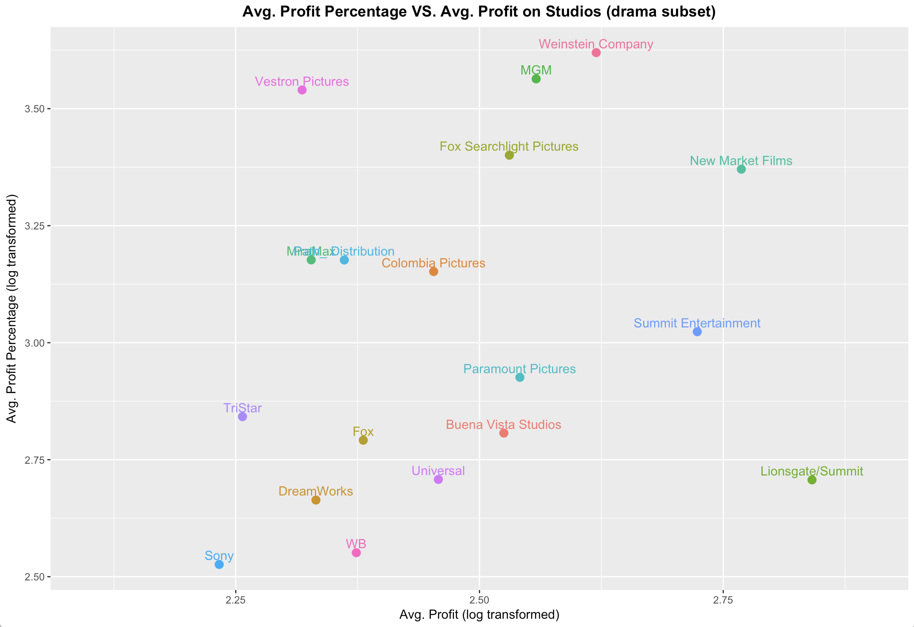
Drama → Best Studio = Weinstein Company
Strategy 2: Max ROI
Max ROI Studio

Slide 13
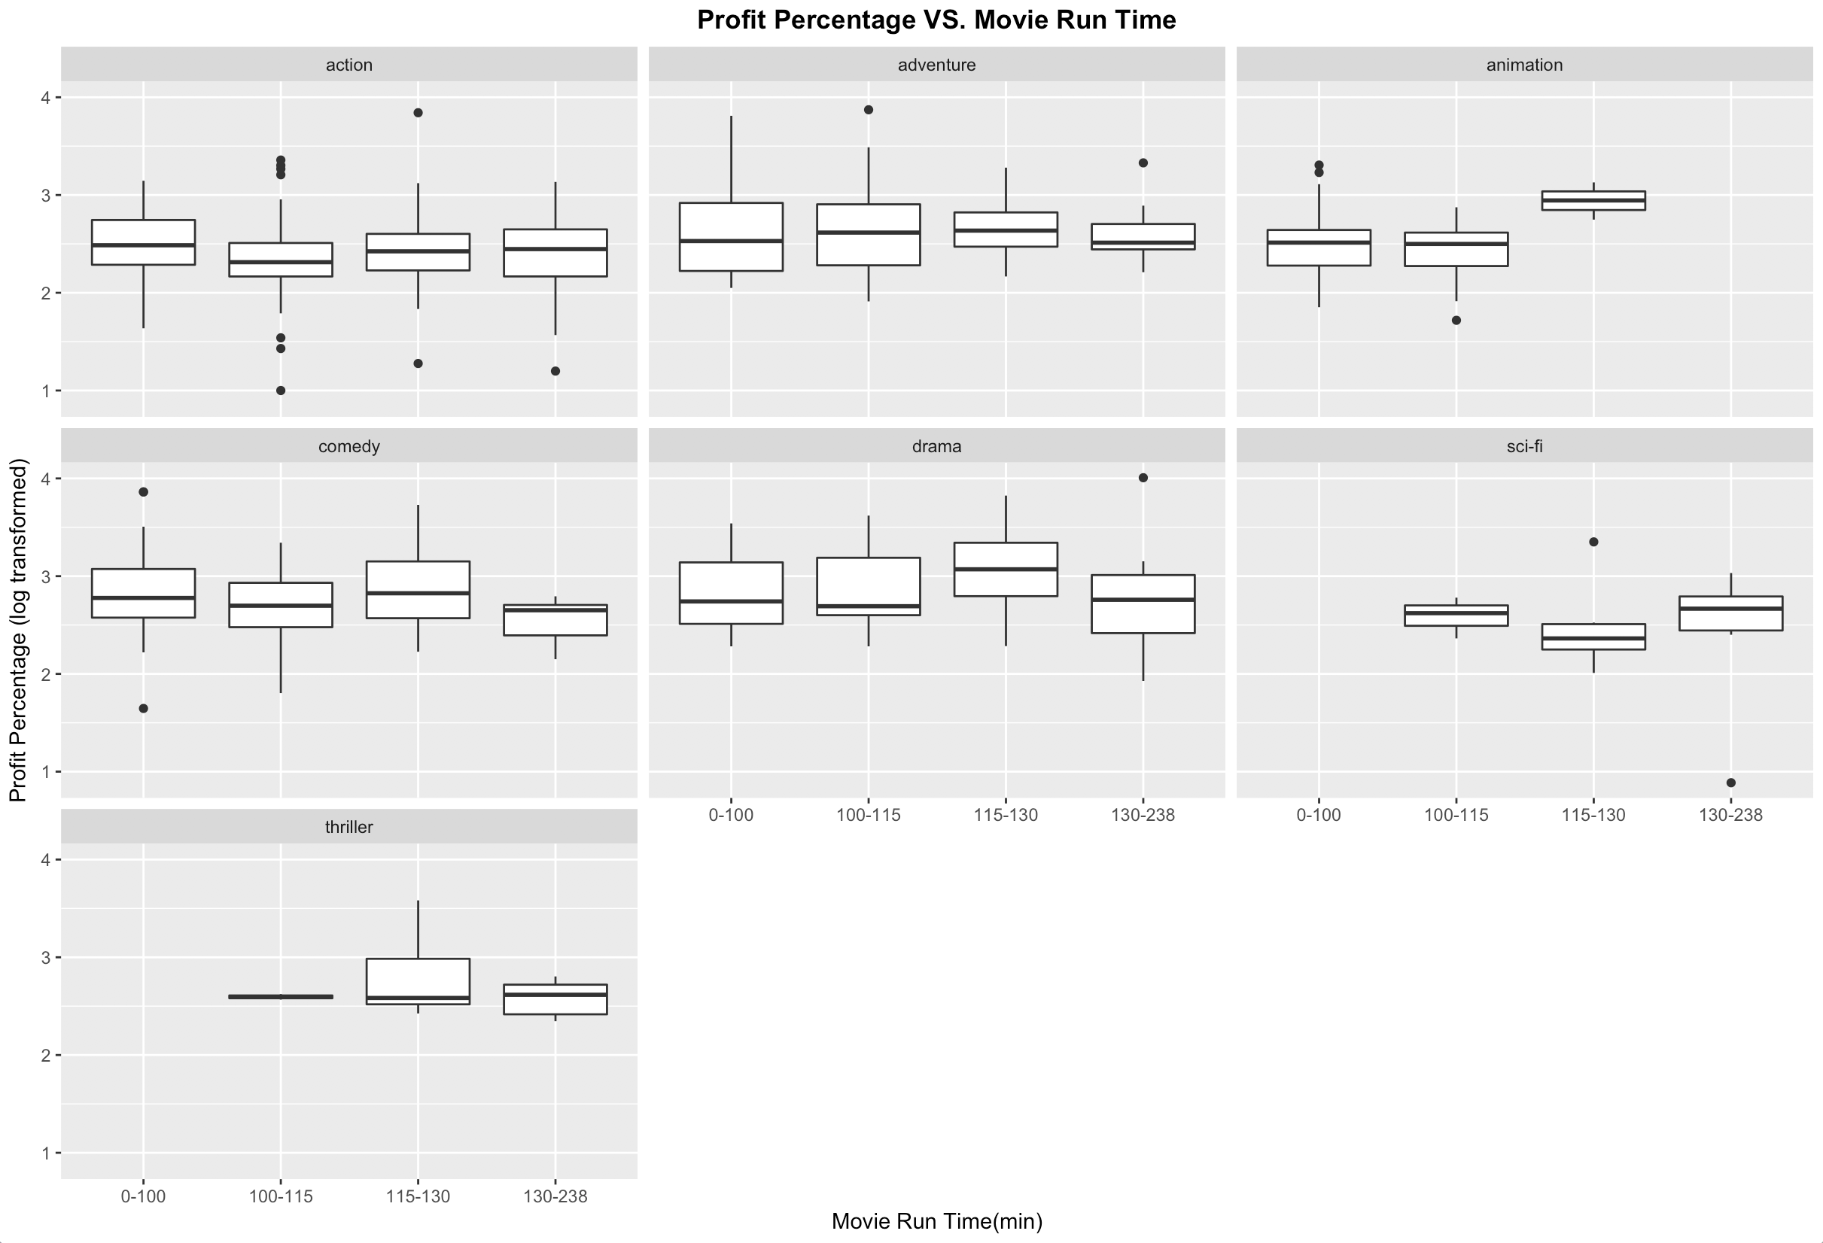
Drama → Best Run-time = 115-130 mins
Strategy 2: Max ROI

Slide 14
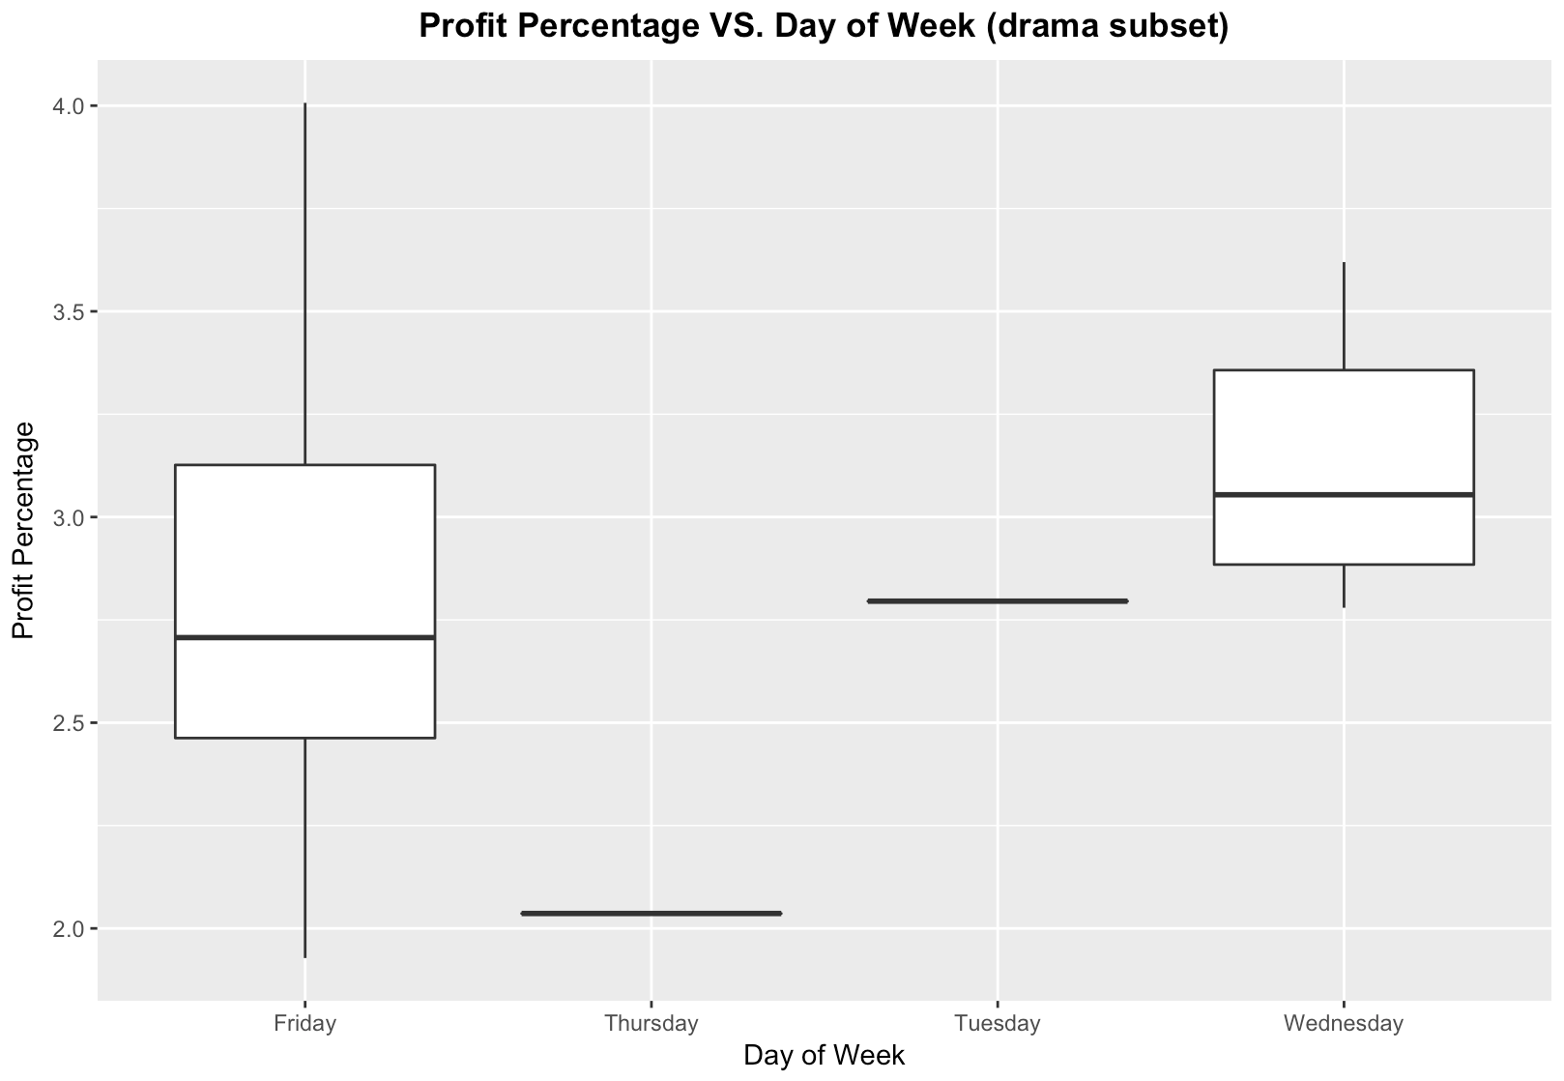
Drama → Best Launch Date = Wednesday
Strategy 2: Max ROI

Slide 15

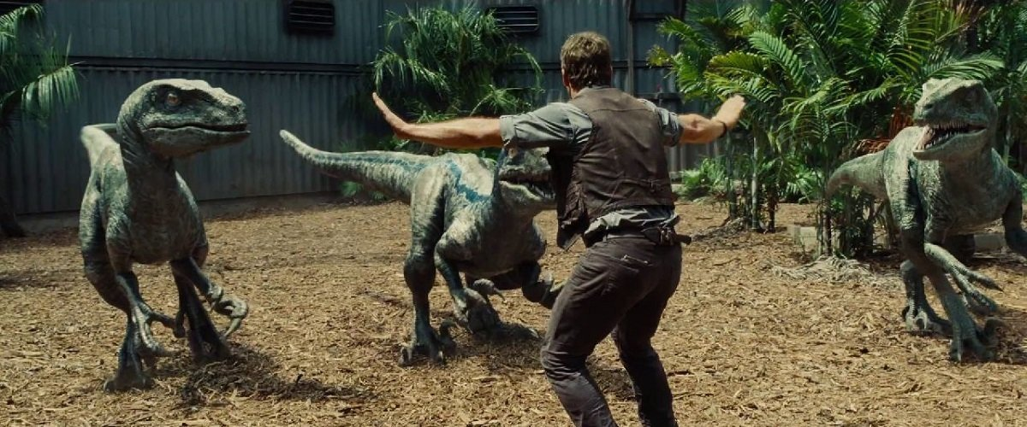
Fantasy
Strategy 1 – Create a movie to Win the MOST $
What is the All-Time Highest Profit-Generating Adventures Movie?
Using today’s advanced Analytics, can we beat this record?

Slide 16

With the right team, maybe!
Director: David Yates (Director of the final 4 Harry Potter films)
Studio: Lionsgate
Run-Time: 115-130 mins
Best Launch Date: Friday!
Return of the Heir
By: LadyBelz During the Marge Dursley Incident just before Harry's third year at Hogwarts, his accidental magic not only causes her to inflate like a balloon, but it also transports him to a little-known island on the other side of the planet. It is there he discovers the true meaning of family. Watch out, Hogwarts! Harry's got a brand new attitude and a whole lot of new friends!
https://www.fanfiction.net/s/12681504/1/Return-of-the-Heir

Slide 17
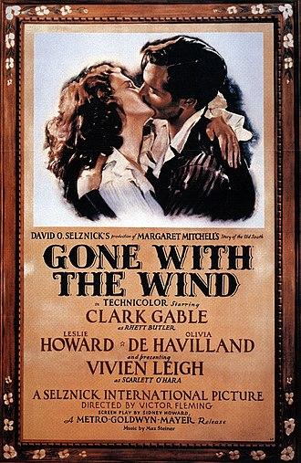
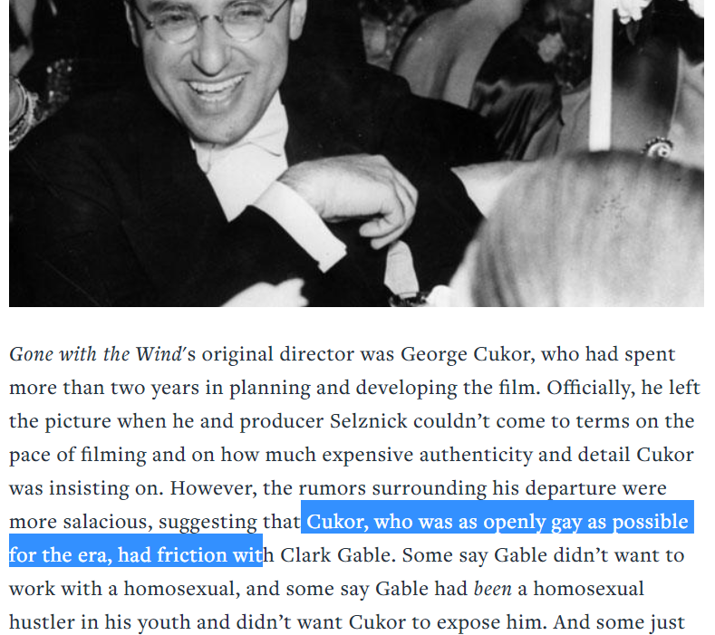
Fantasy
Strategy 2 – Create a movie to Win the BEST ROI
What is the All-Time Highest Profit-Margin Drama Movie?
Using today’s advanced Analytics, can we beat this record?

Slide 18


Going with the Times
With the right team, YES!
Directors: Olivier Nakache & Eric Toledano (The Intouchables)
Studio: Weinstein Companny
Run-Time: 115-130 mins
Best Launch Date: Wednesday!

Slide 19

CREDITS
Director: Talent Fish
Technical Director: Mountain Go
Cinematographer: Gaga
Editor: Cute Ferret
Executive Producer: Happy

